Slide 1
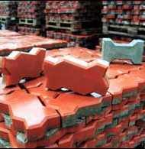
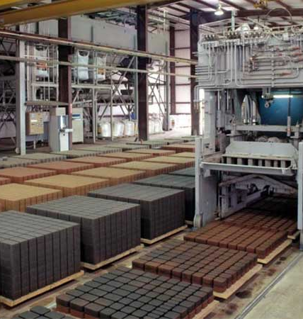
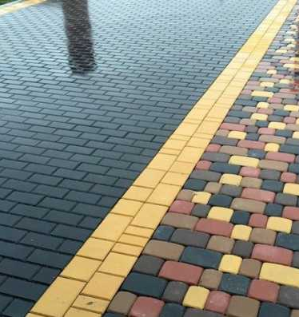
Paving tiles
Following the booming construction sector, the demand for high quality construction materials, including outdoor finishing materials like paving tiles is increasing. Production is based on local resource base and supported by qualified personnel and low operational costs
$0,3 mln
$0,3 mln
650 thousand pieces
Republic of Karakalpakstan, Nukus town
IRR: 30,8%
NPV: $0,4 mln
Local market
34 months
Available
Nukus town administration
nukus.q@karakalpakstan.uz
+99861 2229798

