Slide 1
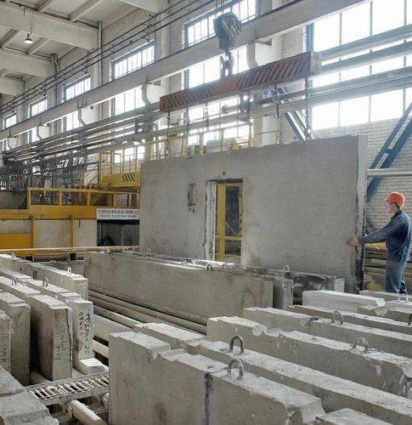
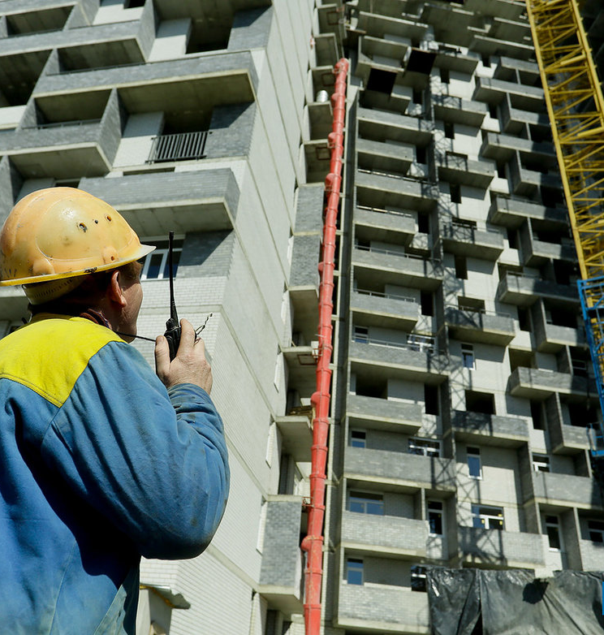
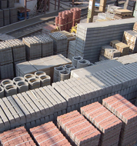
Prefabricated concrete construction materials
The ongoing construction boom pushes the construction materials industry to produce high quality, energy efficient and durable materials, reducing costs and time of construction simultaneously increasing quality. Production is based on local resource base. The project shall enjoy high demand on the local market
$3 mln
$3 mln
90 000
square meters
Jizzakh region
Dustlik district
IRR: 53%
NPV: $9 mln
Export: 50%
Local market: 50%
18 months
Available
Dustlik district administration
dostlik@jizzax.uz
+99872 3354463

