Slide 1
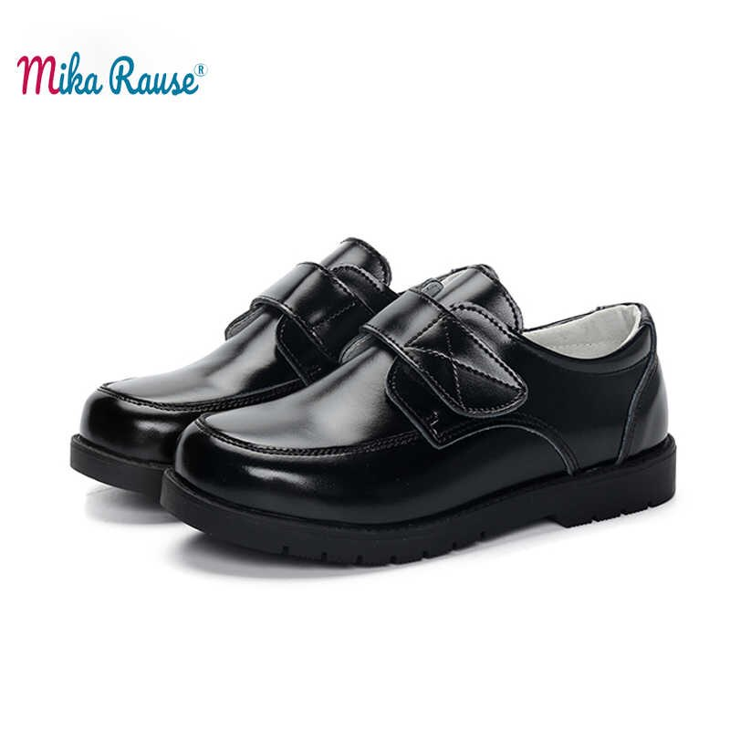
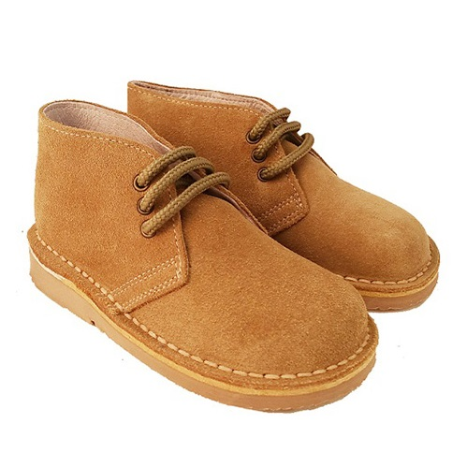
Leather kids' footwear production
Leather products manufacturing is a growing business in Uzbekistan with its own resource base potentials and historical ground. The request for a modern up-to-date technology factory for kid’s footwear is quite high, supported by a vast local market as well as export opportunities to neighboring markets. Qualified personnel and resource base availability. Low operating costs.
$0,6 mln
$0,6 mln
100,000 pairs of shoes
Republic Of Karakalpakstan, Nukus town
IRR: 27,5%
NPV: $0,7 mln
Export: 100%
31 months
Available
Nukus town administration
nukus.q@karakalpakstan.uz
+99861 2229798

