Slide 1
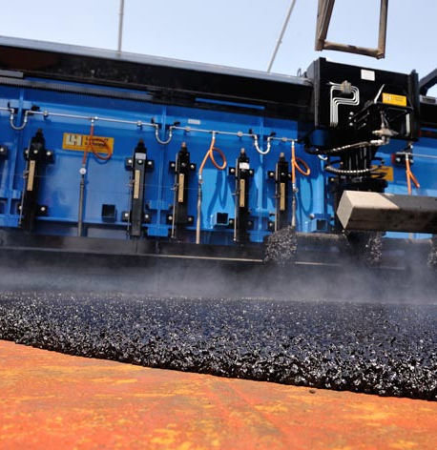
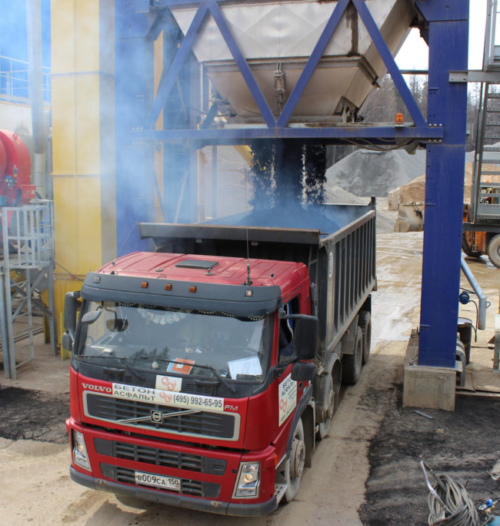
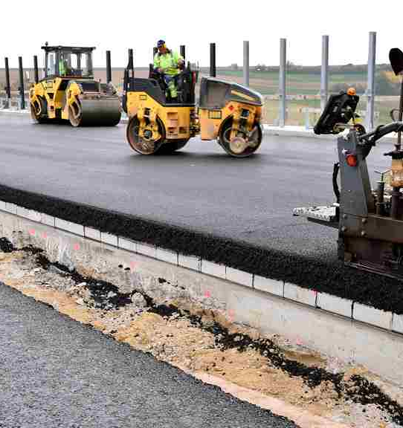
Asphalt plant
Tarmac roads network is highly developed in Uzbekistan. In addition many new roads are under construction. Ongoing construction creates stable demand for an quality asphalt. The production is based on local raw materials, but tar, which is imported, nevertheless, this project is considered as a very attractive business
$2,5 mln
$2,5 mln
2’560 tons asphalt
Bukhara region
Vobkent district
IRR: 17%
NPV: $1,4 mln
Export: 50%
Local market: 50%
53 months
Available
Vobkent district administration
bekzod8968@umail.uz
+99865 3321175

