Slide 1
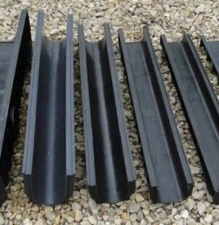
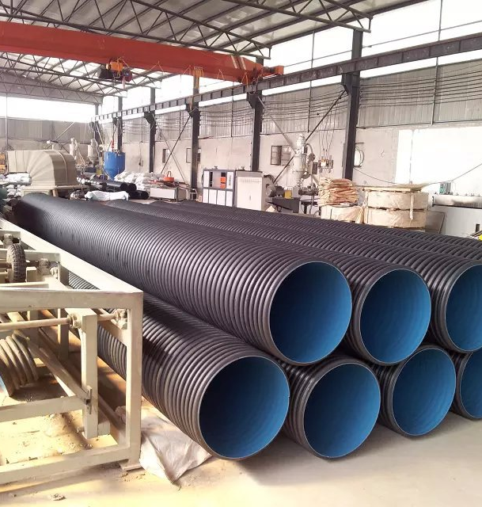
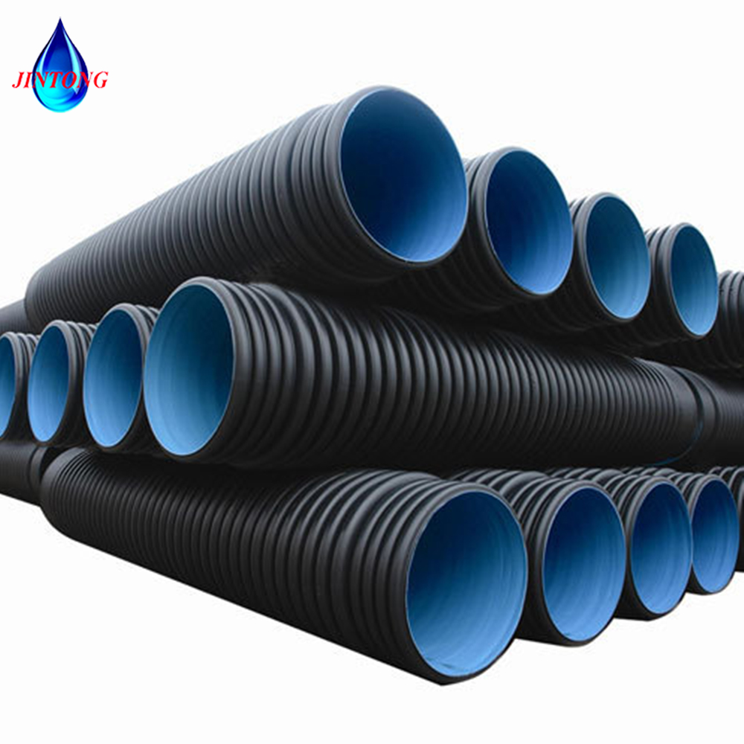
Plastic trays and pipes
These products are highly demanded both by construction industry as well as agricultural sector (irrigation and drainage). Production is based on available local raw materials and shall benefit from low operational costs and qualified personnel
$1,4 mln
$1,4 mln
1000 km pipes and trays
Bukhara region
Jondor district
IRR: 23%
NPV: $1,3 mln
Local market: 100%
36 months
Available
Jondor district administration
jondor_inv@inbox.uz
+99865 5821792

