Slide 1
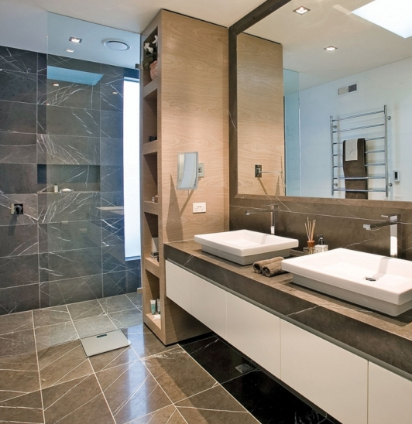
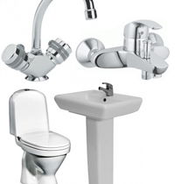
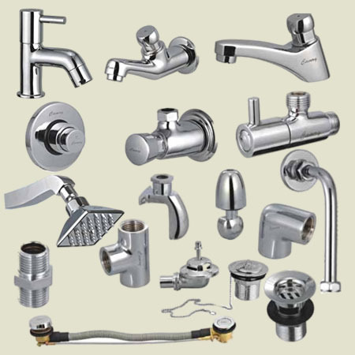
Production of plumbing
Plumbing products are highly demanded on the local market, boosted by the blooming construction sector. The project can benefit from availability of qualified personnel as well as low operational costs
$2 mln
$2 mln
48’000 pieces sanitary goods
Surkhandarya region,
Termez city
IRR: 47%
NPV: $5 mln
Local market: 100%
24 months
Available
Termez city adminstration
otabek1980ort@gmail.
com
+99876 2241500

