Slide 1
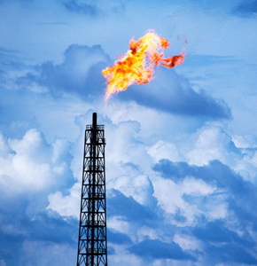
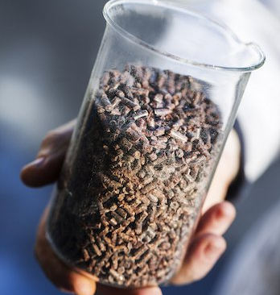
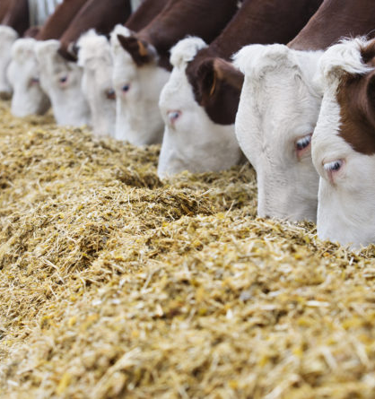
Bio proteins - Gaprin
The Government of Uzbekistan is supporting and welcoming deeper natural-gas processing productions. Considering cattle, poultry and aquaculture sectors development in the country demand for high-quality fodder adding is growing exponentially. Production of gaprin will definitely be a very attractive business for any investor
$225,2 mln
$225,2 mln
100 000 tons of gaprin
Surkhandarya region, Boysun district
IRR: 10,2%
NPV: $45,0 mln
Local market: 100%
68 months
Available
Boysun district administration
mr.umedillo@mail.ru
+99876 3352612

